Slide 1
Software Quality Assurance
Dr. Seemab Latif
Lecture No. 7
16th March, 2011

Slide 2
Software Quality Control Tools
Also known as Ishikawa's seven basic tools for quality control.
Promoted by Ishikawa in 1989.

Slide 3
Seven Quality Control Tools
These seven tools are used for process and quality control in software development at the project and organization level
hence, are useful for project leaders and process experts.
These tools do not provide specific information to software developers on how to improve the quality of their designs or implementation.
Ishikawa's seven basic tools for quality control are checklist, Pareto diagram, histogram, scatter diagram, run chart, control chart, and cause-and-effect diagram.

Slide 4
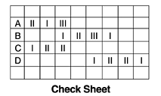
Tool 1--Checklist
A check sheet is a paper form with printed items to be checked.
Its main purposes are:
to facilitate gathering data and
to arrange data while collecting it so the data can be easily used later.
As a senior software development manager at a major software organization observed, checklists that summarize the key points of the process are much more effective than the lengthy process documents

Slide 5
When to Use a Checklist
When data can be observed and collected repeatedly by the same person or at the same location.
When collecting data on the frequency or patterns of events, problems, defects, defect location, defect causes, etc.
When collecting data from a production process.

Slide 6
Checklist Procedure
Decide what event or problem will be observed. Develop operational definitions.
Decide when data will be collected and for how long.
Design the form. Set it up so that data can be recorded simply by making check marks or Xs or similar symbols and so that data do not have to be recopied for analysis.
Label all spaces on the form.
Test the check sheet for a short trial period to be sure it collects the appropriate data and is easy to use.
Each time the targeted event or problem occurs, record data on the check sheet.

Slide 7
Checklists-- Example
At IBM Rochester, the software development process consists of multiple phases, for example, requirements (RQ), system architecture (SD), high-level design (HLD), low-level design (LLD), code development (CODE), unit tests (UT), integration and building (I/B), component tests (CT), system tests (ST), and early customer programs (EP).
Each phase has a set of tasks to complete and the phases with formal hand-off have entry and exit criteria. Checklists help developers and programmers ensure that all tasks are complete and that the important factors or quality characteristics of each task are covered.
Several examples of checklists are design review checklist, code inspection checklist, moderator (for design review and code inspection) checklist, pre-code-integration (into the system library) checklist, entrance and exit criteria for system tests, and product readiness checklist.

Slide 8
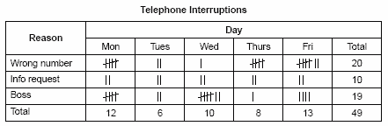
Checklists-- Example
The figure below shows a check sheet used to collect data on telephone interruptions. The tick marks were added as data was collected over several weeks.

Slide 9
Tool 2-- Pareto Diagram
A Pareto diagram is a frequency chart of bars in descending order; the frequency bars are usually associated with types of problems.
It is named after a nineteenth-century Italian economist named Vilfredo Pareto (1848–1923), who expounded his principle in terms of the distribution of wealth—that a large share of the wealth is owned by a small percentage of the population.
In 1950 Juran applied the principle to the identification of quality problems-- that most of the quality problems are due to a small percentage of the possible causes.

Slide 10
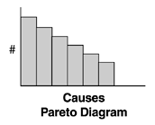
Pareto Diagram
In software development, the X-axis for a Pareto diagram is usually the defect cause and the Y-axis the defect count.
By arranging the causes based on defect frequency, a Pareto diagram can identify the few causes that account for the majority of defects. It indicates which problems should be solved first in eliminating defects and improving the operation.
Pareto analysis is commonly referred to as the 80–20 principle (20% of the causes account for 80% of the defects), although the cause-defect relationship is not always in an 80–20 distribution.

Slide 11
When to Use a Pareto Chart
When analyzing data about the frequency of problems or causes in a process.
When there are many problems or causes and you want to focus on the most significant.
When analyzing broad causes by looking at their specific components.
When communicating with others about your data

Slide 12
Pareto Chart Procedure
Decide what categories you will use to group items.
Decide what measurement is appropriate. Common measurements are frequency, quantity, cost and time.
Decide what period of time the Pareto chart will cover: One work cycle? One full day? A week?
Collect the data, recording the category each time.
Subtotal the measurements for each category.
Determine the appropriate scale for the measurements you have collected. Mark the scale on the left side of the chart.
Construct and label bars for each category. Place the tallest at the far left, then the next tallest to its right and so on. If there are many categories with small measurements, they can be grouped as “other.”

Slide 13
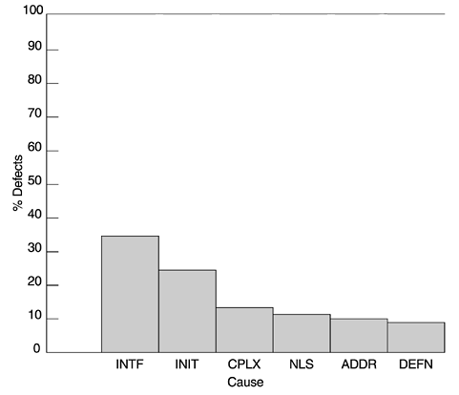
Pareto Diagram-- Example
This graph shows an example of a Pareto analysis of the causes of defects for an IBM Rochester product. Interface problems (INTF) and data initialization problems (INIT) were found to be the dominant causes for defects in that product. By focusing on these two areas throughout the design, implementation, and test processes, and by conducting technical education by peer experts, significant improvement was observed.
The other defect causes in the figure include complex logical problems (CPLX), translation-related national language problems (NLS), problems related to addresses (ADDR), and data definition problems (DEFN).

Slide 14
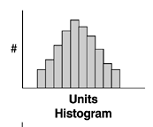
Tool 3-- Histogram
The histogram is a graphic representation of frequency counts of a sample or a population.
The X-axis lists the unit intervals of a parameter (e.g., severity level of software defects) ranked in ascending order from left to right, and the Y-axis contains the frequency counts.

Slide 15
Histogram
Difference between Pareto and histogram:
In a histogram, the frequency bars are shown by the order of the X variable
whereas in a Pareto diagram the frequency bars are shown by order of the frequency counts.
The purpose of the histogram is to show the distribution characteristics of a parameter such as overall shape, central tendency, dispersion, and skewness.
It enhances understanding of the parameter of interest.

Slide 16
When to Use a Histogram
When the data are numerical.
When you want to see the shape of the data’s distribution, especially when determining whether the output of a process is distributed approximately normally.
When analyzing whether a process can meet the customer’s requirements.
When analyzing what the output from a supplier’s process looks like.
When seeing whether a process change has occurred from one time period to another.
When determining whether the outputs of two or more processes are different.
When you wish to communicate the distribution of data quickly and easily to others.

Slide 17
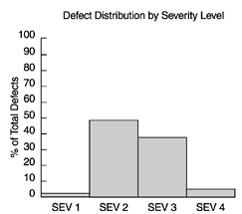
Histogram-- Example
Graph below shows an example of histogram used for software project and quality management. It shows the defect frequency of a product by severity level (from 1 to 4 with 1 being the most severe and 4 the least).
Defects with different severity levels differ in their impact on customers. Less severe defects usually have circumventions available and to customers they mean inconvenience.
In contrast, high-severity defects may cause system downtime and affect customers' business. Therefore, given the same defect rate (or number of defects), the defect severity histogram tells a lot more about the quality of the software

Slide 18
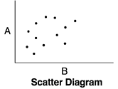
Tool 4– Scatter Diagram
A scatter diagram portrays the relationship of two interval variables.
In a cause-effect relationship, the X-axis is for the independent variable and the Y-axis for the dependent variable.
Each point in a scatter diagram represents an observation of both the dependent and independent variables.
Scatter diagrams aid data-based decision making (e.g., if action is planned on the X variable and some effect is expected on the Y variable).

Slide 19
Scatter Diagram
One should always look for a scatter diagram when the correlation coefficient of two variables is presented.
This is because the method for calculating the correlation coefficient is highly sensitive to outliers, and a scatter diagram can clearly expose any outliers in the relationship.
Second, the most common correlation coefficient is Pearson's product moment correlation coefficient, which assumes a linear relationship. If the relationship is nonlinear, the Pearson correlation coefficient may show no relationship; therefore, it may convey incorrect or false information.
Compared to other tools, the scatter diagram is more difficult to apply. It usually relates to investigative work and requires precise data. It is often used with other techniques such as correlational analysis, regression, and statistical modelling.

Slide 20
When to Use a Scatter Diagram
When you have paired numerical data.
When your dependent variable may have multiple values for each value of your independent variable.
When trying to determine whether the two variables are related, such as…
When trying to identify potential root causes of problems.
When determining whether two effects that appear to be related both occur with the same cause.
When testing for autocorrelation before constructing a control chart.

Slide 21
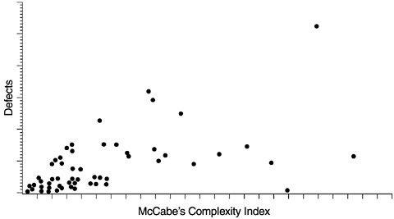
Scatter Diagram-- Example
This diagram illustrates the relationship between McCabe's complexity index and defect level.
Each data point represents a program module with the X coordinate being its complexity index and the Y coordinate its defect level.
Because program complexity can be measured as soon as the program is complete, whereas defects are discovered over a long time, the positive correlation between the two allows us to use program complexity to predict defect level.
Furthermore, we can reduce the program complexity when it is developed (as measured by McCabe's index), thereby reducing the chance for defects. Reducing complexity can also make programs easier to maintain.

Slide 22
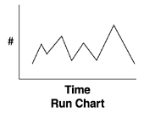
Tool 5-- Run Chart
A run chart tracks the performance of the parameter of interest over time.
The X-axis is time and the Y-axis is the value of the parameter.
A run chart is best used for trend analysis, especially if historical data are available for comparisons with the current trend.
An example of a run chart in software is the weekly number of open problems in the backlog; it shows the development team's workload of software fixes.

Slide 23
When to Use Run Charts
Before collecting data.
When data come from several sources or conditions, such as shifts, days of the week, suppliers or population groups.
When data analysis may require separating different sources or conditions.

Slide 24
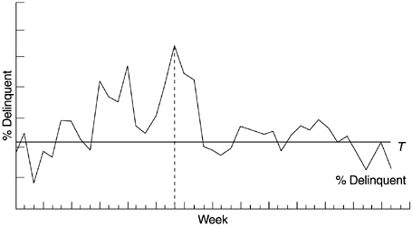
Run Chart-- Example
Given below is a run chart for the weekly percentage of delinquent open reports of field defects (defect reports that were not yet closed with fixes by the response time criteria) of an IBM Rochester product.
The horizontal line (denoted by the letter T ) is the target delinquency rate. The dashed vertical line denotes the time when special remedial actions were rolled out to combat the high delinquency rate.
For each delinquent defect report, causal analysis was done and corresponding actions implemented.

Slide 25
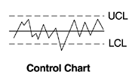
Tool 6-- Control Chart
A control chart can be regarded as an advanced form of a run chart for situations where the process capability can be defined.
It consists of a central line, a pair of control limits (and sometimes a pair of warning limits within the control limits), and values of the parameter of interest plotted on the chart, which represent the state of a process.
The X-axis is real time. If all values of the parameter are within the control limits and show no particular tendency, the process is regarded as being in a controlled state. If they fall outside the control limits or indicate a trend, the process is considered out of control. Such cases call for causal analysis and corrective actions are to be taken.

Slide 26
When to Use a Control Chart
When controlling ongoing processes by finding and correcting problems as they occur.
When predicting the expected range of outcomes from a process.
When determining whether a process is stable (in statistical control).
When analyzing patterns of process variation from special causes (non-routine events) or common causes (built into the process).
When determining whether your quality improvement project should aim to prevent specific problems or to make fundamental changes to the process.

Slide 27
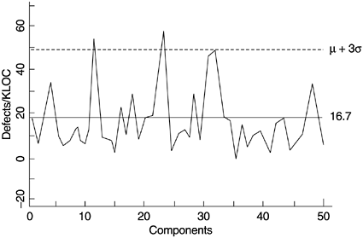
Control Chart-- Example
Graph shows a pseudo-control chart on testing defects per KLOC by component for a project at IBM Rochester, from which error-prone components were identified for further in-depth analysis and actions.
In this case, the use of the control chart involved more than one iteration. In the first iteration, components with defect rates outside the control limits (particularly high) were identified. (It should be noted that in this example the control chart is one-sided with only the upper control limit.)

Slide 28
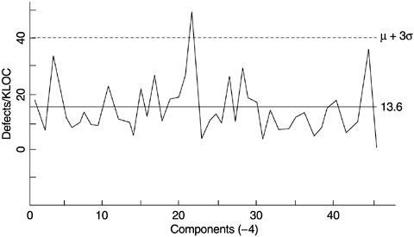
Control Chart-- Example
In the second iteration, the previously identified error-prone components were removed and the data were plotted again, with a new control limit.
This process of "peeling the onion" permitted the identification of the next set of potentially defect-prone components, some of which may have been masked on the initial charts. This process can continue for a few iterations.

Slide 29
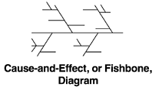
Tool 7-- Cause-and-Effect Diagram
The cause-and-effect diagram is also known as the fishbone diagram.
It was first used to explain factors that affect the production of steel.
It shows the relationship between a quality characteristic and factors that affect that characteristic.
Its layout resembles a fishbone, with the quality characteristic of interest labelled at the fish head, and factors affecting the characteristics placed where the bones are located.
While the scatter diagram describes a specific bivariate relationship in detail, the cause-and-effect diagram identifies all causal factors of a quality characteristic in one chart.

Slide 30
When to Use a Fishbone Diagram
When identifying possible causes for a problem.
Especially when a team’s thinking tends to fall into channels.

Slide 31
Fishbone Diagram Procedure
Agree on a problem statement (effect). Write it at the centre right of the flipchart or whiteboard. Draw a box around it and draw a horizontal arrow running to it.
Brainstorm the major categories of causes of the problem
Write the categories of causes as branches from the main arrow.
Brainstorm all the possible causes of the problem. Ask: “Why does this happen?” As each idea is given, the facilitator writes it as a branch from the appropriate category. Causes can be written in several places if they relate to several categories.
Again ask “why does this happen?” about each cause. Write sub-causes branching off the causes. Continue to ask “Why?” and generate deeper levels of causes. Layers of branches indicate causal relationships.
When the group runs out of ideas, focus attention to places on the chart where ideas are few.

Slide 32
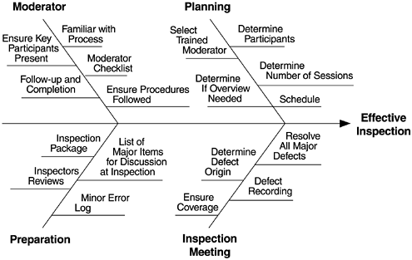
Cause-and-Effect Diagram-- Example
Diagram below shows a fishbone diagram relating the key factors to effective inspections.

Slide 33
Summary
Seven tools for quality control in an organization are:
Check list: A structured, prepared form for collecting and analyzing data; a generic tool that can be adapted for a wide variety of purposes.
Pareto chart: Shows on a bar graph which factors are more significant.
Histogram: The most commonly used graph for showing frequency distributions, or how often each different value in a set of data occurs.
Control charts: Graphs used to study how a process changes over time.
Run Charts: A technique that separates data gathered from a variety of sources so that patterns can be seen.
Scatter diagram: Graphs pairs of numerical data, one variable on each axis, to look for a relationship.
Cause-and-effect diagram (also called Ishikawa or fishbone chart): Identifies many possible causes for an effect or problem and sorts ideas into useful categories.
These tools do not provide specific information to software developers on how to improve the quality of their designs or implementation, but how to control the quality of the software by identifying the probable causes of defects.

